Slide 1

CS 584 Machine Learning
Week 9
October 16, 2019

Slide 2

Week 9 Agenda: Dimension Reduction
Mid-Term Test Recap
Feature Avoidance / Selection
Feature Importance Index
Chapter 6 of the Machine Learning book

Slide 3
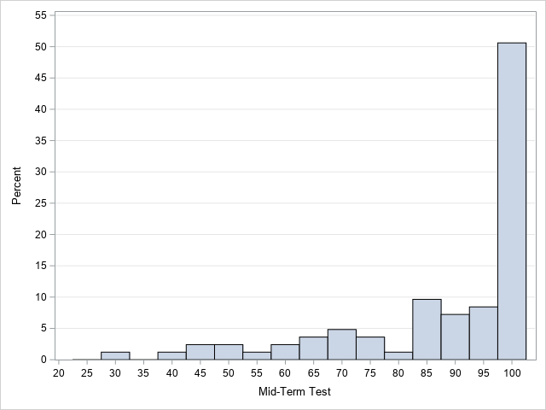
Mid-Term Test Recap
84 students took and completed the test
Unaudited Median is 97.5
Answer Key uploaded.

Slide 4
Feature Selection in Model Building
AVOID
SELECT
Intuitively think the features are good for model building
TRAIN
Features can be further examined and securitized
Subjectively withhold features from consideration

Slide 5
Why Select Feature in Model Building?
Personally Identifiable Information (PII) or Protected Health Information (PHI) are prohibited from being used for any predictive models
Resources (e.g., memory, disk space, processor speed) limit the number of features that can be fed into a computer program
Weakness in algorithms or flaws in implementation (e.g., dealing with collinearity, handling of missing values)

Slide 6
Avoid These Features (At least, seek an opinion before using them)
PII
Personally Identifiable Information
Any information that can be used to distinguish or trace an individual’s identity such as name, social security number, date and place of birth, mother’s maiden name, or biometric records
PHI
Protected Health Information
Any information in a medical record that can be used to identify an individual, including billing information, test results, prescription records, communication records, and scheduling records
Discriminatory
Features that challenge the state of fairness
The Equal Employment Opportunity Act (EEOA) of 1972 and the Age Discrimination in Employment Act (ADEA) of 1967
Beware of the General Data Protection Regulation (GDPR) in the European Union
Mandated by the Health Insurance Portability and Accountability Act of 1996 (HIPAA)
ADEA forbids age discrimination against people who are age 40 or older
EEOA prohibits employment discrimination based on race, color, religion, sex, or national origin

Slide 7
Use These Features At Your Own Risk
Single Category
A particular category occurs too often
Relative frequency of that category is equal to or above a threshold
Constant Value
The values are within a narrow range
Coefficient of Variation (Std.Dev. / Mean) is below a threshold
Missing Value
Majority of observations are missing
Percent of missing observations is above a threshold
Many Distinct Categories
Many categories occur rarely
Relative frequencies of the majority of categories are below a threshold
May consume lot of resources
Algorithm may not anticipate
May cause machine underflow
Algorithm may not handle

Slide 8

Required Feature Inclusion
Certain features are included whatsoever due to business practice in an industry
U.S. regions or census tracts for data that have a geographical element
Marketing incentives in studying customer purchase behavior

Slide 9
Need to Identify Helpful Features
Number of Features
From the viewpoint of a data scientist, too many features may be equally troublesome as too few features
Learner Algorithm
An algorithm is useful and effective only if it can take all the features that are specified, no matter how powerful it is
Identify the Helpful
Therefore, we need to identify the features that help predict the target accurately before specifying them in the algorithm

Slide 10
Identify the Helpful Features
Appropriate Statistical Test |  | Target Variable
 |  | Categorical | Interval
Input Feature | Categorical | Chi-square | ANOVA
 | Interval | Deviance | Regression

Slide 11
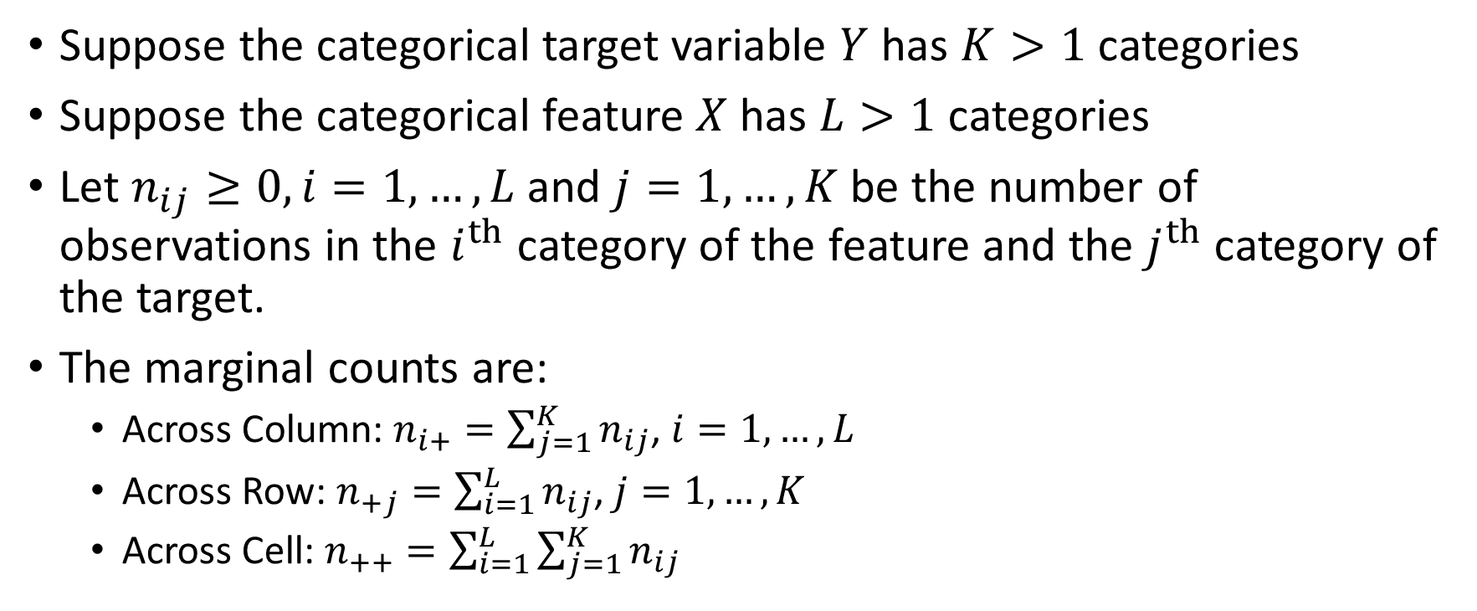
Chi-square Test
Suppose the categorical target variable $Y$ has $K>1$ categories
Suppose the categorical feature $X$ has $L>1$ categories
Let $n_{ij}≥0, i=1,…, L$ and $j=1,…,K$ be the number of observations in the $i^{th}$ category of the feature and the $j^{th}$ category of the target.
The marginal counts are:
Across Column: $n_{i+}=\sum_{j=1}^{K}{n_{ij}}$, $i=1,…, L$
Across Row: $n_{+j}=\sum_{i=1}^{L}{n_{ij}}$, $j=1,…,K$
Across Cell: $n_{++}=\sum_{i=1}^{L}{\sum_{j=1}^{K}{n_{ij}}}$

Slide 12
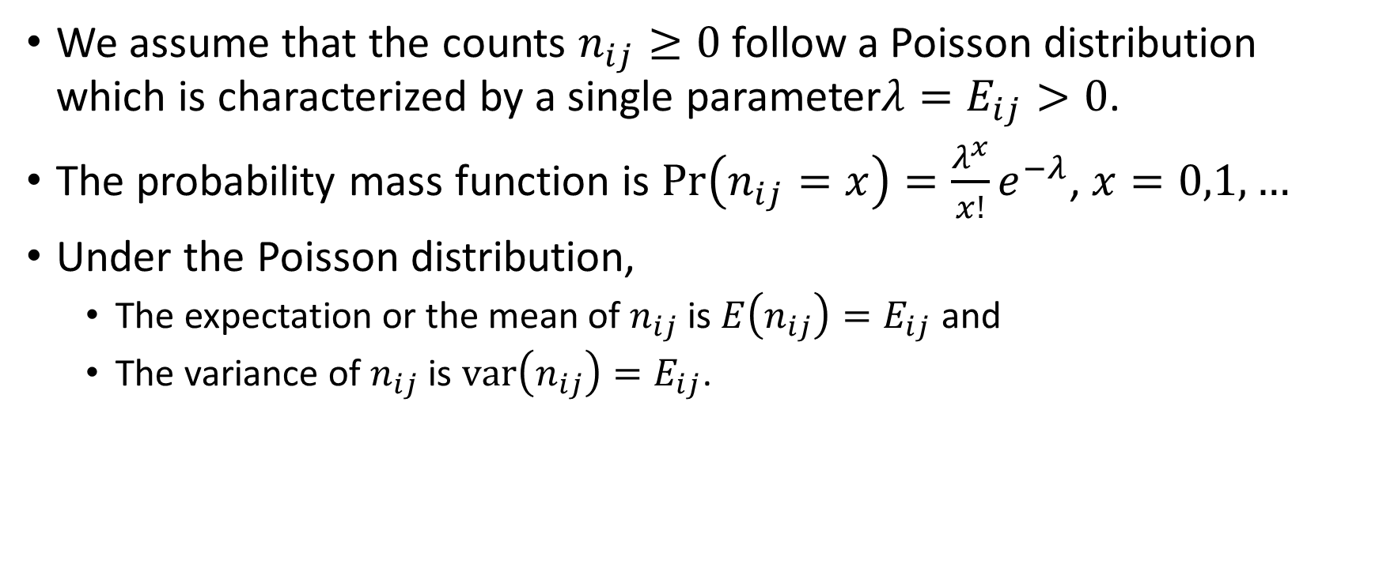
Chi-square Test – Poisson Distribution
We assume that the counts $n_{ij}≥0$ follow a Poisson distribution which is characterized by a single parameter$λ=E_{ij}>0$.
The probability mass function is $Pr\left(n_{ij}=x\right)=\frac{λ^{x}}{x!}e^{−λ}$, $x=0,1,…$
Under the Poisson distribution,
The expectation or the mean of $n_{ij}$ is $E\left(n_{ij}\right)=E_{ij}$ and
The variance of $n_{ij}$ is $var\left(n_{ij}\right)=E_{ij}$.

Slide 13
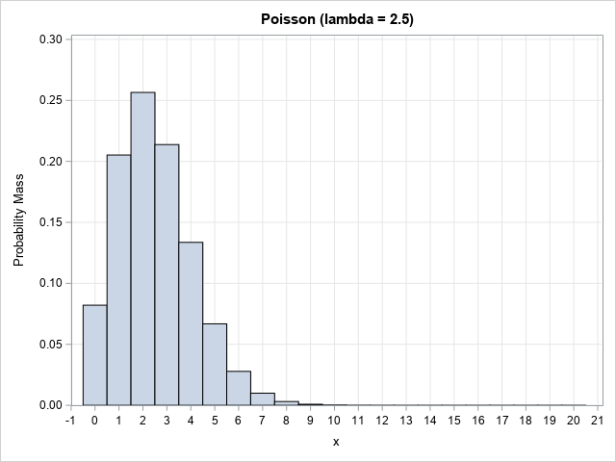
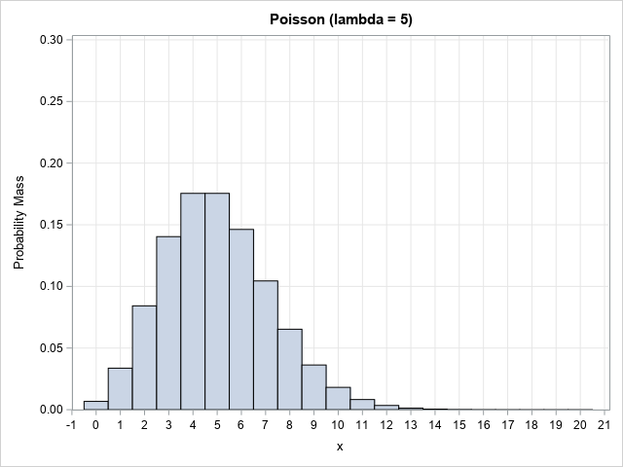
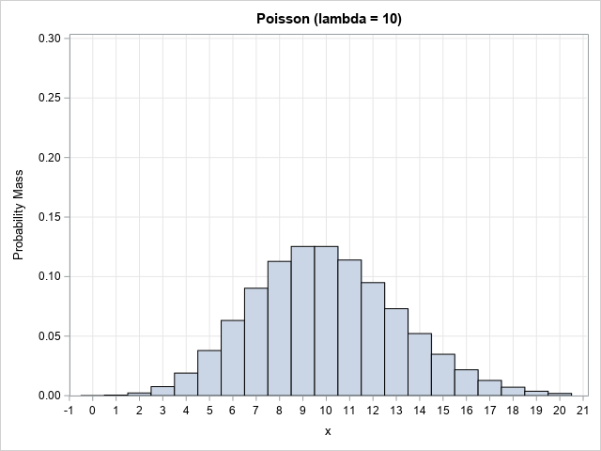
Poisson Distribution
Python Function | Density | Distribution | Significance | Quantile | Random Number
scipy.stats.poisson | .pmf() | .cdf() | .sf() | .ppf() | .rvs()

Slide 14
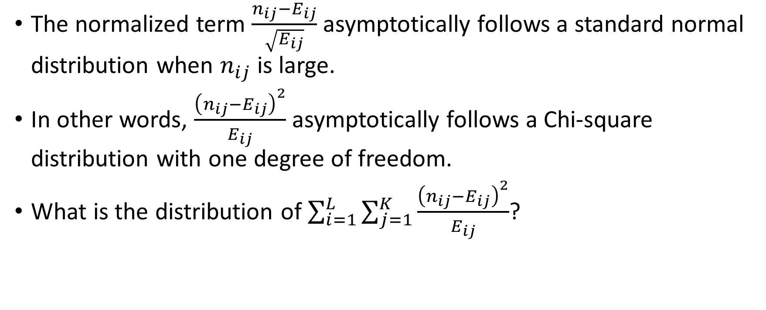
Chi-square Test
The normalized term $\frac{n_{ij}−E_{ij}}{\sqrt{E_{ij}}}$ asymptotically follows a standard normal distribution when $n_{ij}$ is large.
In other words, $\frac{{\left(n_{ij}−E_{ij}\right)}^{2}}{E_{ij}}$ asymptotically follows a Chi-square distribution with one degree of freedom.
What is the distribution of $\sum_{i=1}^{L}{\sum_{j=1}^{K}{\frac{{\left(n_{ij}−E_{ij}\right)}^{2}}{E_{ij}}}}$?

Slide 15
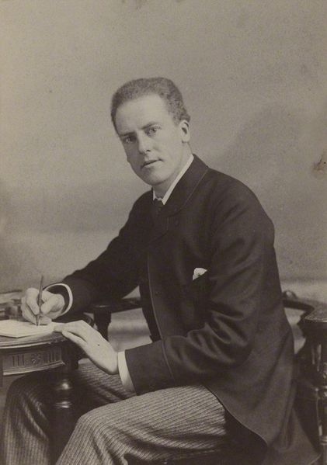
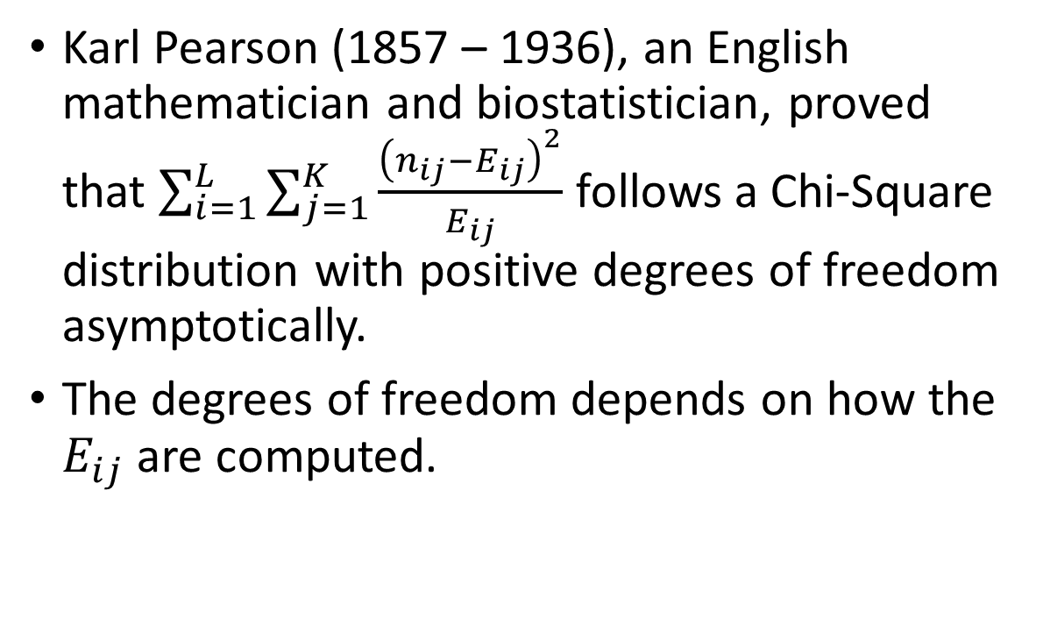
Chi-square Test
Karl Pearson (1857 – 1936), an English mathematician and biostatistician, proved that $\sum_{i=1}^{L}{\sum_{j=1}^{K}{\frac{{\left(n_{ij}−E_{ij}\right)}^{2}}{E_{ij}}}}$ follows a Chi-Square distribution with positive degrees of freedom asymptotically.
The degrees of freedom depends on how the $E_{ij}$ are computed.

Slide 16
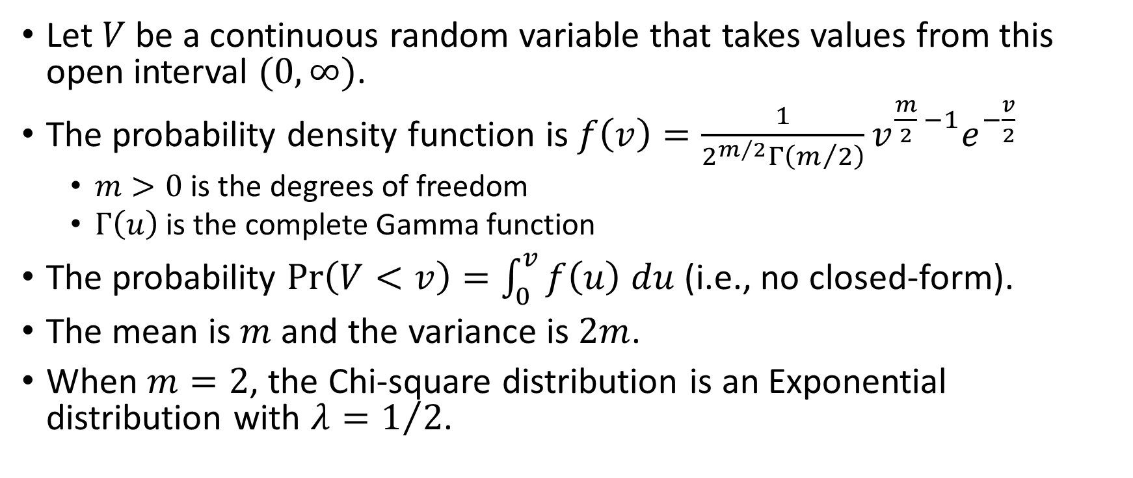
Chi-Square Distribution
Let $V$ be a continuous random variable that takes values from this open interval $(0,∞)$.
The probability density function is $f\left(v\right)=\frac{1}{2^{m/2}Γ\left(m/2\right)}v^{\frac{m}{2} −1}e^{−\frac{v}{2}}$
$m>0$ is the degrees of freedom
$Γ\left(u\right)$ is the complete Gamma function
The probability $Pr\left(V<v\right)=\int_{0}^{v}{f\left(u\right) du}$ (i.e., no closed-form).
The mean is $m$ and the variance is $2m$.
When $m=2$, the Chi-square distribution is an Exponential distribution with $λ=1/2$.

Slide 17
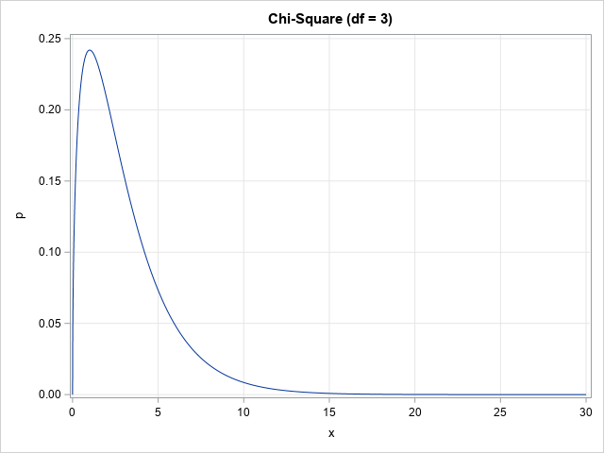
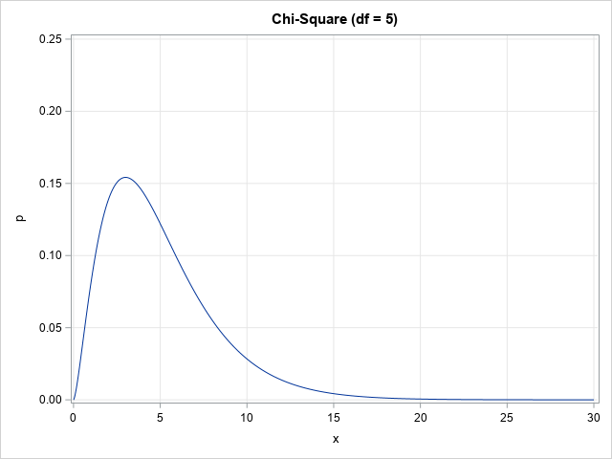
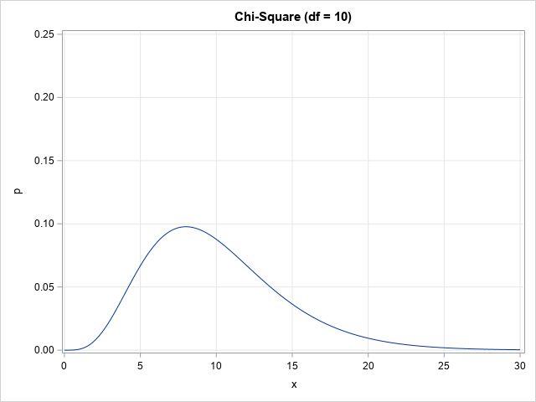
Chi-Square Distribution
Python Function | Density | Distribution | Significance | Quantile | Random Number
scipy.stats.chi2 | .pdf() | .cdf() | .sf() | .ppf() | .rvs()

Slide 18
Chi-square Test – Expected Count
Feature | Target
 | No | Yes | Total
A | 4 | 6 | 10
B | 2 | 3 | 5
C | 8 | 12 | 20
Total | 14 | 21 | 35
IF the feature is statistically independent of the target variable, then the feature will not help predict the target variable
THEN the relative frequencies (or percentages) across the target categories are the same for each feature’s category
THEREFORE, the common relative frequencies are be estimated by ${n_{+j}}/{n_{++}},j=1,…,K$
THEREFORE, the common relative frequencies are be estimated by 𝑛_(+𝑗)∕𝑛_(++) ,𝑗=1,…,𝐾
HENCE, the expected count in the $\left(i,j\right)$ cell is $E_{ij}=n_{i+}\frac{n_{+j}}{n_{++}}$
HENCE, the expected count in the (𝑖,𝑗) cell is 𝐸_𝑖𝑗=𝑛_(𝑖+) 𝑛_(+𝑗)/𝑛_(++)
Feature | Target
 | No | Yes | Total
A | 0.4 | 0.6 | 1
B | 0.4 | 0.6 | 1
C | 0.4 | 0.6 | 1
Total | 0.4 | 0.6 | 1

Slide 19
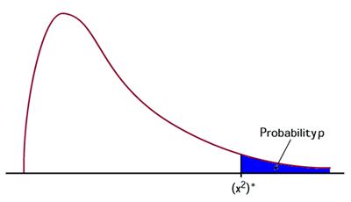
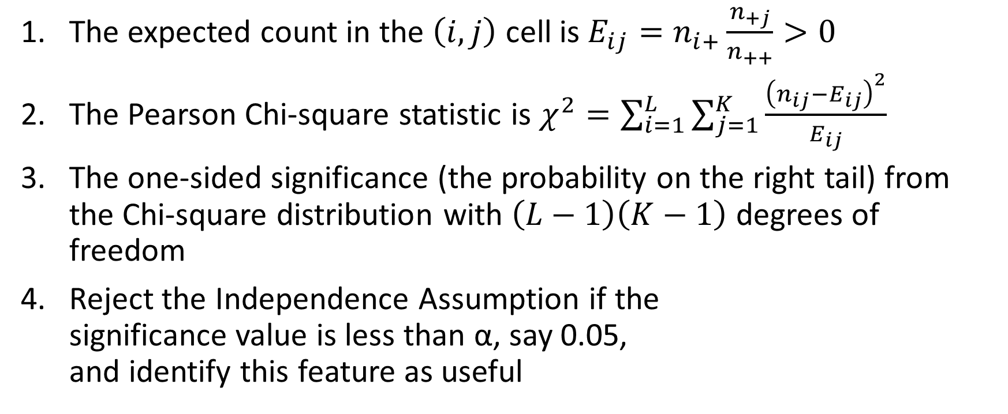
Chi-square Test - Procedure
The expected count in the $\left(i,j\right)$ cell is $E_{ij}=n_{i+}\frac{n_{+j}}{n_{++}}>0$
The Pearson Chi-square statistic is $χ^{2}=\sum_{i=1}^{L}{\sum_{j=1}^{K}{\frac{{\left(n_{ij}−E_{ij}\right)}^{2}}{E_{ij}}}}$
The one-sided significance (the probability on the right tail) from the Chi-square distribution with $\left(L−1\right)\left(K−1\right)$ degrees of freedom
Reject the Independence Assumption if the significance value is less than α, say 0.05, and identify this feature as useful

Slide 20
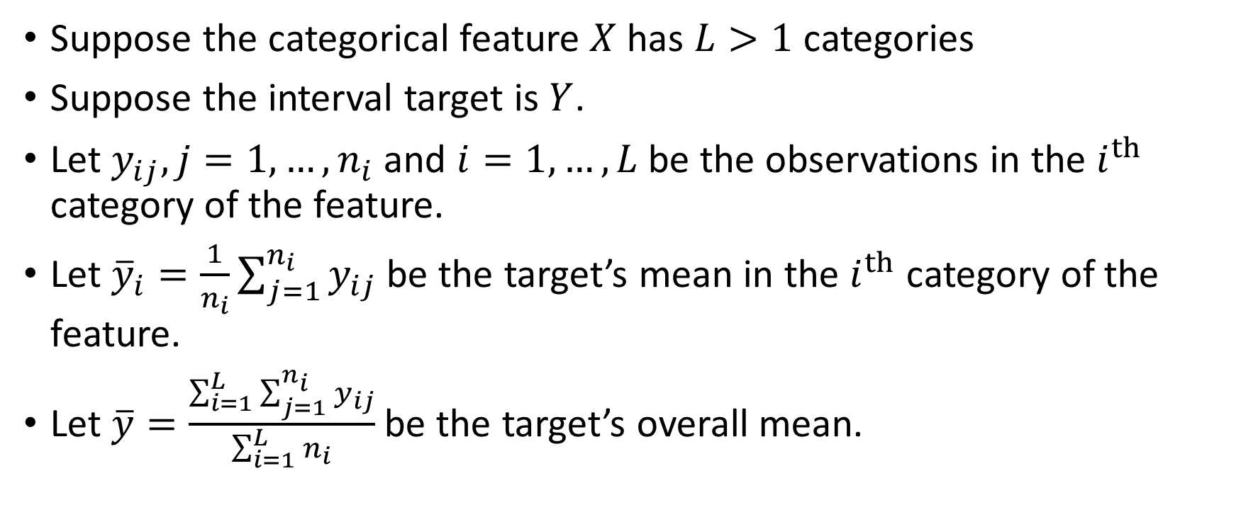
Analysis of Variance (ANOVA) Test
Suppose the categorical feature $X$ has $L>1$ categories
Suppose the interval target is $Y$.
Let $y_{ij}, j=1,…, n_{i}$ and $i=1,…, L$be the observations in the $i^{th}$ category of the feature.
Let ${\overline{y}}_{i}=\frac{1}{n_{i}}\sum_{j=1}^{n_{i}}{y_{ij}}$ be the target’s mean in the $i^{th}$ category of the feature.
Let $\overline{y}=\frac{\sum_{i=1}^{L}{\sum_{j=1}^{n_{i}}{y_{ij}}}}{\sum_{i=1}^{L}{n_{i}}}$ be the target’s overall mean.

Slide 21
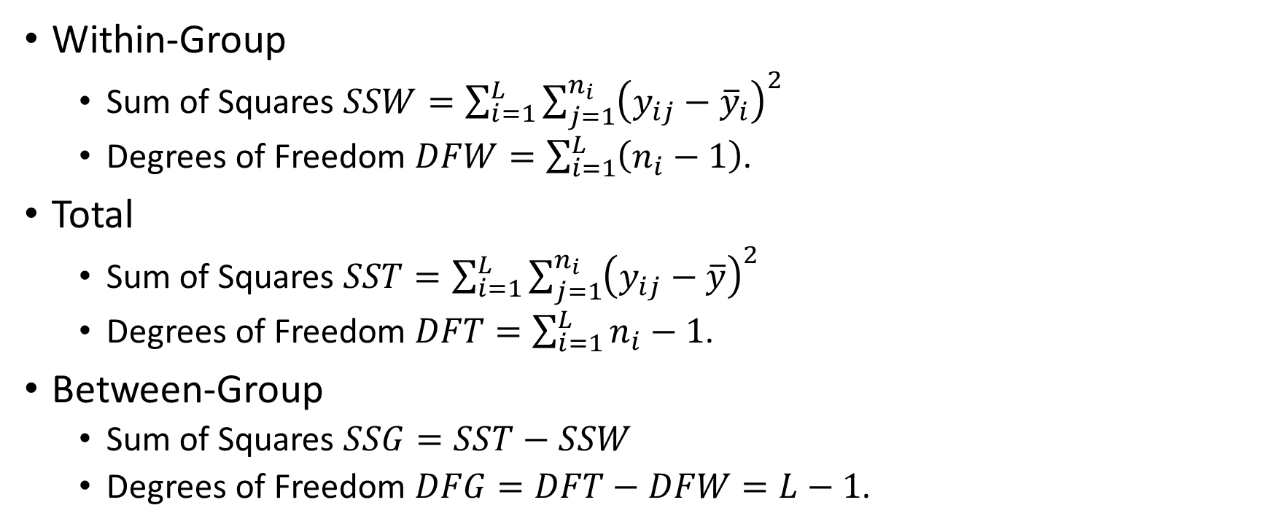
Analysis of Variance (ANOVA) Test
Within-Group
Sum of Squares $SSW=\sum_{i=1}^{L}{\sum_{j=1}^{n_{i}}{{\left(y_{ij}−{\overline{y}}_{i}\right)}^{2}}}$
Degrees of Freedom $DFW=\sum_{i=1}^{L}{\left(n_{i}−1\right)}$.
Total
Sum of Squares $SST=\sum_{i=1}^{L}{\sum_{j=1}^{n_{i}}{{\left(y_{ij}−\overline{y}\right)}^{2}}}$
Degrees of Freedom $DFT=\sum_{i=1}^{L}{n_{i}−1}$.
Between-Group
Sum of Squares $SSG=SST−SSW$
Degrees of Freedom $DFG=DFT−DFW=L−1$.

Slide 22
Analysis of Variance (ANOVA) Test
IF the feature is statistically independent of the target variable, then the feature will not help predict the target variable
THEN the target has the same mean across all feature’s categories
THEREFORE, both ${SSG}/{DFG}$ and ${SSW}/{DFW}$ both estimate the population variance.
THEREFORE, both 𝑆𝑆𝐺∕𝐷𝐹𝐺 and 𝑆𝑆𝑊∕𝐷𝐹𝑊 both estimate the population variance.
HENCE, the ratio $F=\frac{{SSG}/{DFG}}{{SSW}/{DFW}}$ follows a F distribution
HENCE, the ratio 𝐹=(𝑆𝑆𝐺∕𝐷𝐹𝐺)/(𝑆𝑆𝑊∕𝐷𝐹𝑊) follows a F distribution

Slide 23
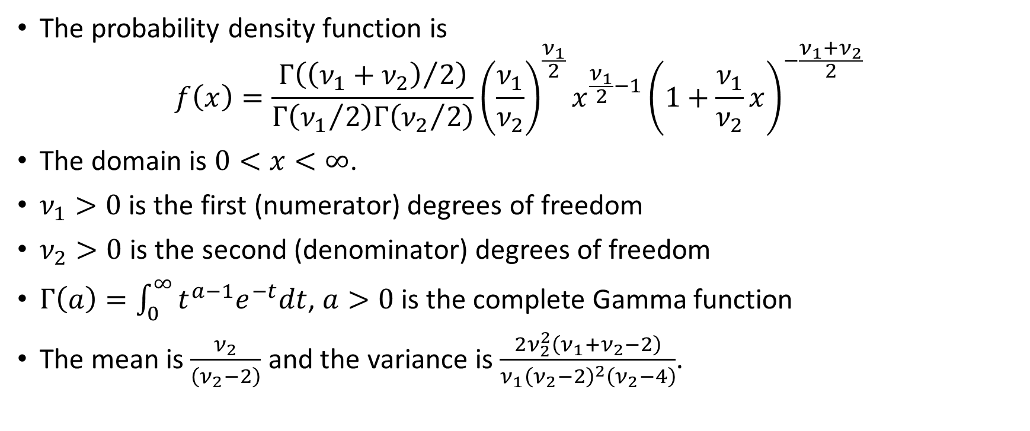
Continuous – F Distribution
The probability density function is
$$f\left(x\right)=\frac{Γ\left({\left(ν_{1}+ν_{2}\right)}/2\right)}{Γ\left({ν_{1}}/2\right)Γ\left({ν_{2}}/2\right)}{\left(\frac{ν_{1}}{ν_{2}}\right)}^{\frac{ν_{1}}{2}}x^{\frac{ν_{1}}{2}−1}{\left(1+\frac{ν_{1}}{ν_{2}}x\right)}^{−\frac{ν_{1}+ν_{2}}{2}}$$
The domain is $0<x<∞$.
$ν_{1}>0$ is the first (numerator) degrees of freedom
$ν_{2}>0$ is the second (denominator) degrees of freedom
$Γ\left(a\right)=\int_{0}^{∞}{t^{a−1}e^{−t}dt}$, $a>0$ is the complete Gamma function
The mean is $\frac{ν_{2}}{\left(ν_{2}−2\right)}$ and the variance is $\frac{2ν_{2}^{2}\left(ν_{1}+ν_{2}−2\right)}{ν_{1}{\left(ν_{2}−2\right)}^{2}\left(ν_{2}−4\right)}$.

Slide 24
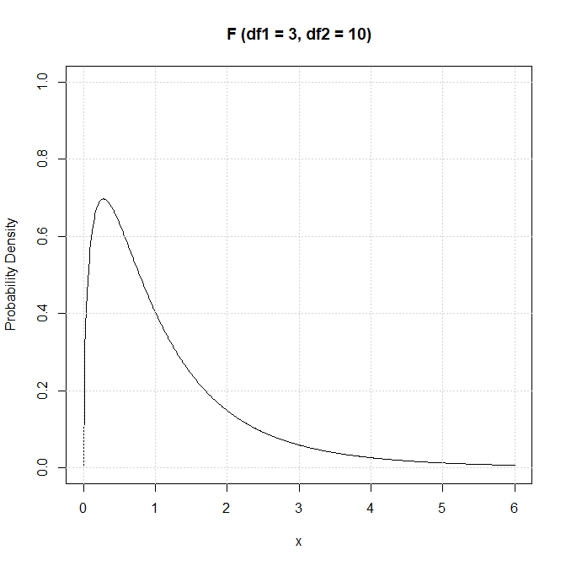
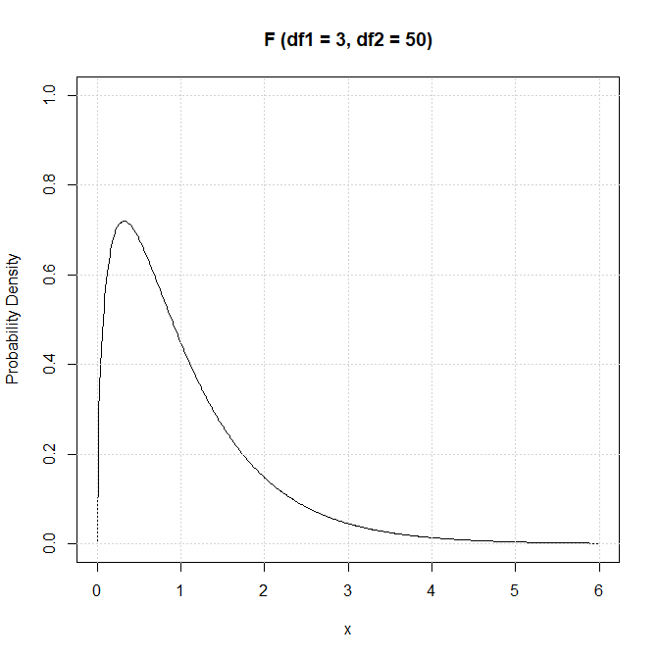
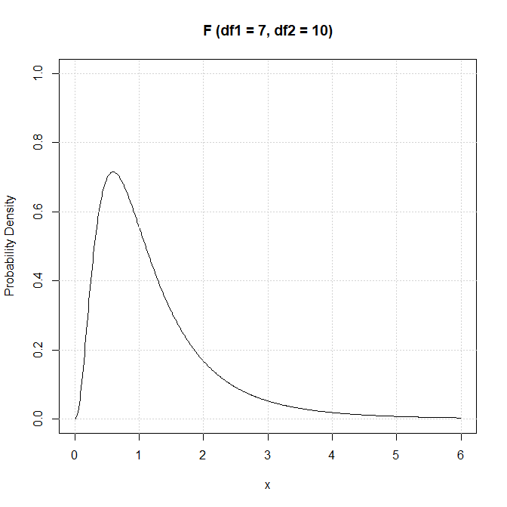
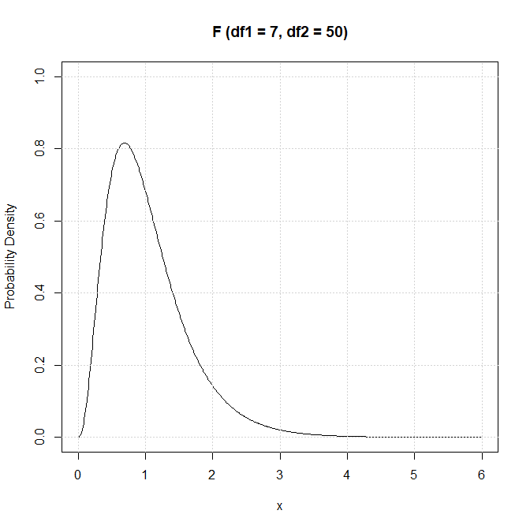
Continuous – F Distribution
Python Function | scipy.stats.f
Density | .pdf()
Distribution | .cdf()
Significance | .sf()
Quantile | .ppf()
Random Number | .rvs()

Slide 25
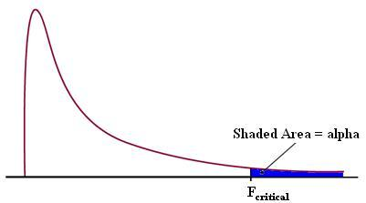
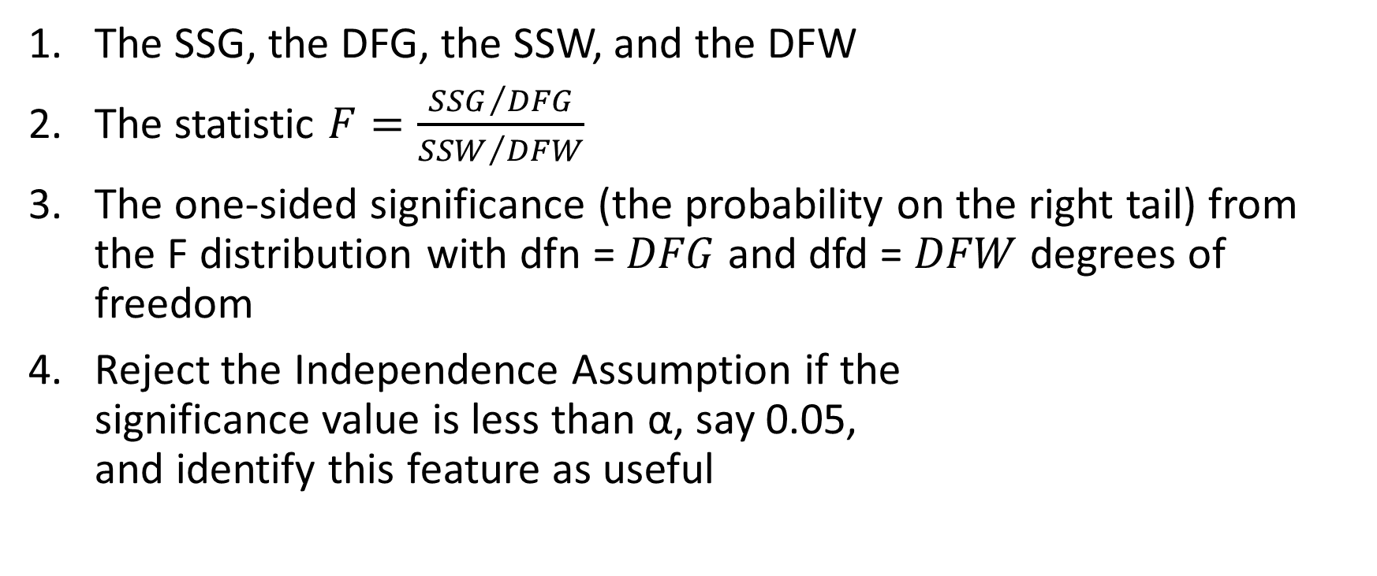
F Test - Procedure
The SSG, the DFG, the SSW, and the DFW
The statistic $F=\frac{{SSG}/{DFG}}{{SSW}/{DFW}}$
The one-sided significance (the probability on the right tail) from the F distribution with dfn = $DFG$ and dfd = $DFW$ degrees of freedom
Reject the Independence Assumption if the significance value is less than α, say 0.05, and identify this feature as useful

Slide 26
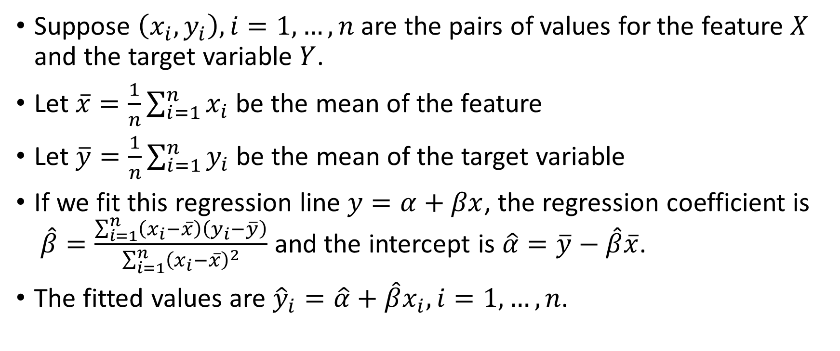
Regression Test
Suppose $\left(x_{i}, y_{i}\right), i=1,…,n$ are the pairs of values for the feature $X$ and the target variable $Y$.
Let $\overline{x}=\frac{1}{n}\sum_{i=1}^{n}{x_{i}}$ be the mean of the feature
Let $\overline{y}=\frac{1}{n}\sum_{i=1}^{n}{y_{i}}$ be the mean of the target variable
If we fit this regression line $y=α+βx$, the regression coefficient is $\hat{β}=\frac{\sum_{i=1}^{n}{\left(x_{i}−\overline{x}\right)\left(y_{i}−\overline{y}\right)}}{\sum_{i=1}^{n}{{\left(x_{i}−\overline{x}\right)}^{2}}}$ and the intercept is $\hat{α}=\overline{y}−\hat{β}\overline{x}$.
The fitted values are ${\hat{y}}_{i}=\hat{α}+\hat{β}x_{i},i=1,…,n$.

Slide 27
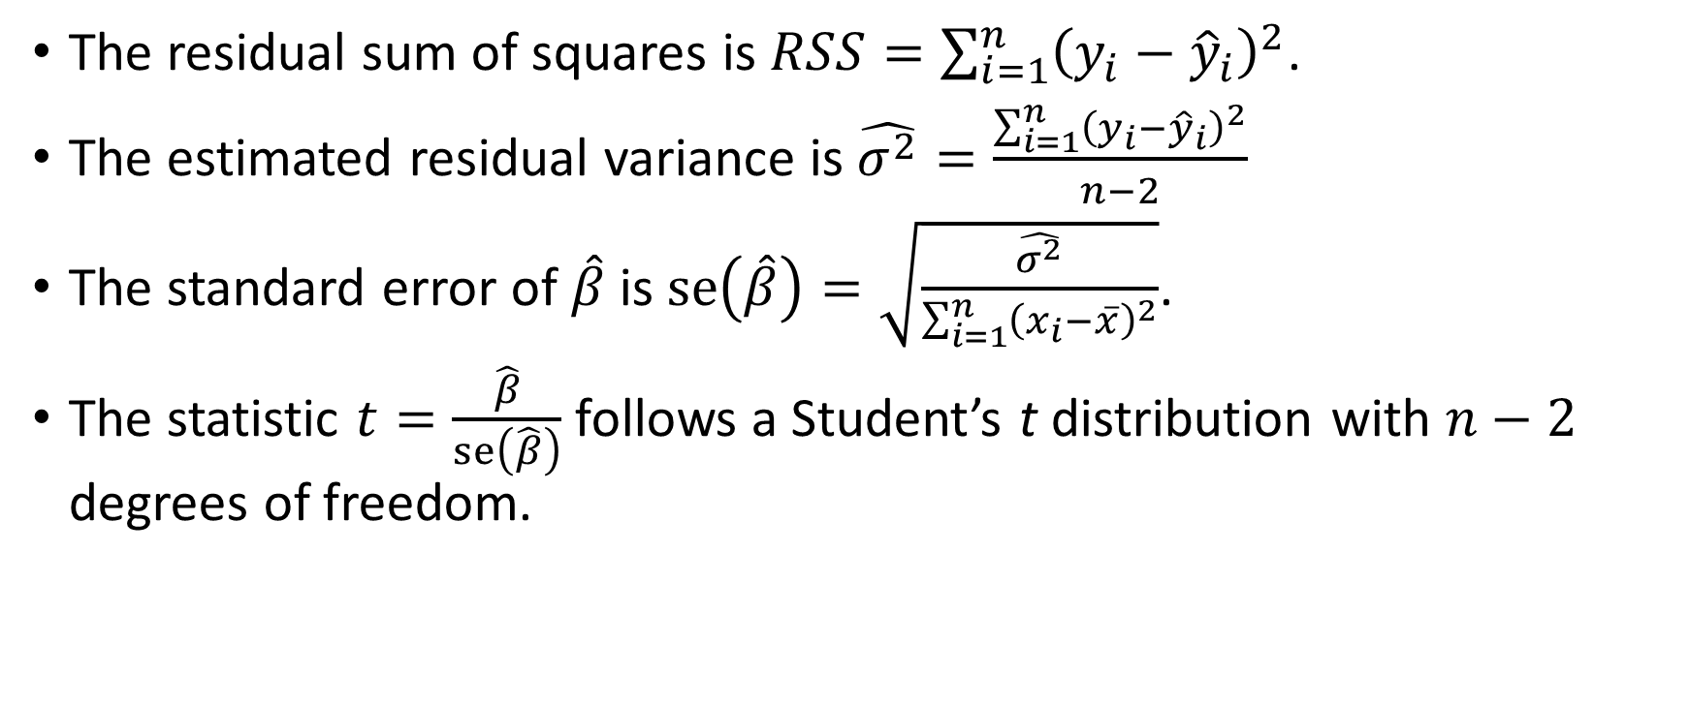
Regression Test
The residual sum of squares is $RSS=\sum_{i=1}^{n}{{\left(y_{i}−{\hat{y}}_{i}\right)}^{2}}$.
The estimated residual variance is $\hat{σ^{2}}=\frac{\sum_{i=1}^{n}{{\left(y_{i}−{\hat{y}}_{i}\right)}^{2}}}{n−2}$
The standard error of $\hat{β}$is $se\left(\hat{β}\right)=\sqrt{\frac{\hat{σ^{2}}}{\sum_{i=1}^{n}{{\left(x_{i}−\overline{x}\right)}^{2}}}}$.
The statistic $t=\frac{\hat{β}}{se\left(\hat{β}\right)}$ follows a Student’s t distribution with $n−2$ degrees of freedom.

Slide 28
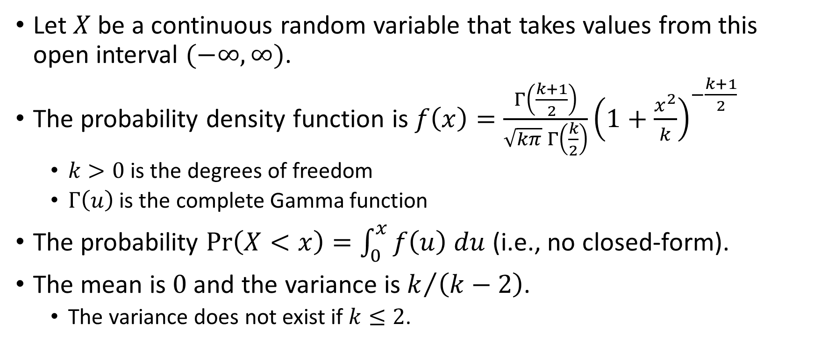
Continuous – Student’s t Distribution
Let $X$ be a continuous random variable that takes values from this open interval $(−∞,∞)$.
The probability density function is $f\left(x\right)=\frac{Γ\left(\frac{k+1}{2}\right)}{\sqrt{kπ} Γ\left(\frac{k}{2}\right)}{\left(1+\frac{x^{2}}{k}\right)}^{−\frac{k+1}{2}}$
$k>0$ is the degrees of freedom
$Γ\left(u\right)$ is the complete Gamma function
The probability $Pr\left(X<x\right)=\int_{0}^{x}{f\left(u\right) du}$ (i.e., no closed-form).
The mean is $0$ and the variance is $k/{\left(k−2\right)}$.
The variance does not exist if $k≤2$.

Slide 29
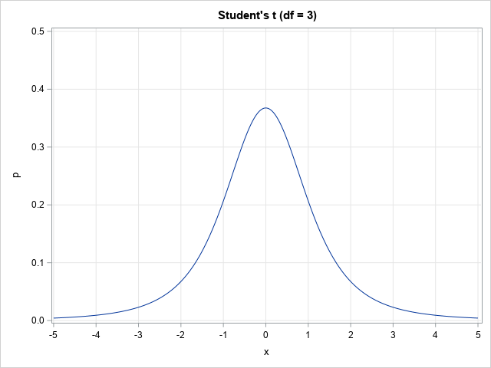
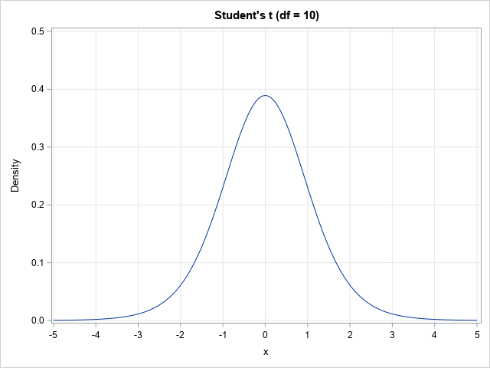
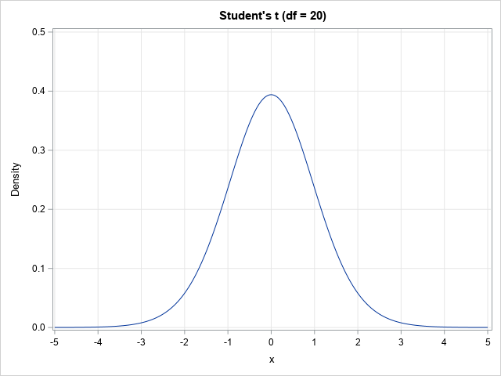
Continuous – Student’s t Distribution
Python Function | Density | Distribution | Significance | Quantile | Random Number
scipy.stats.t | .pdf() | .cdf() | .sf() | .ppf() | .rvs()

Slide 30
Regression Test
IF the feature is statistically independent of the target variable, then the feature will not help predict the target variable
THEN the regression coefficient $β$ is zero
THEN the regression coefficient 𝛽 is zero
THEREFORE, the absolute value of statistic $t=\frac{\hat{β}}{se\left(\hat{β}\right)}$ should be small.
THEREFORE, the absolute value of statistic 𝑡=𝛽 ̂/se(𝛽 ̂ ) should be small.

Slide 31
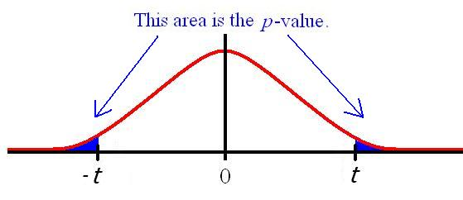
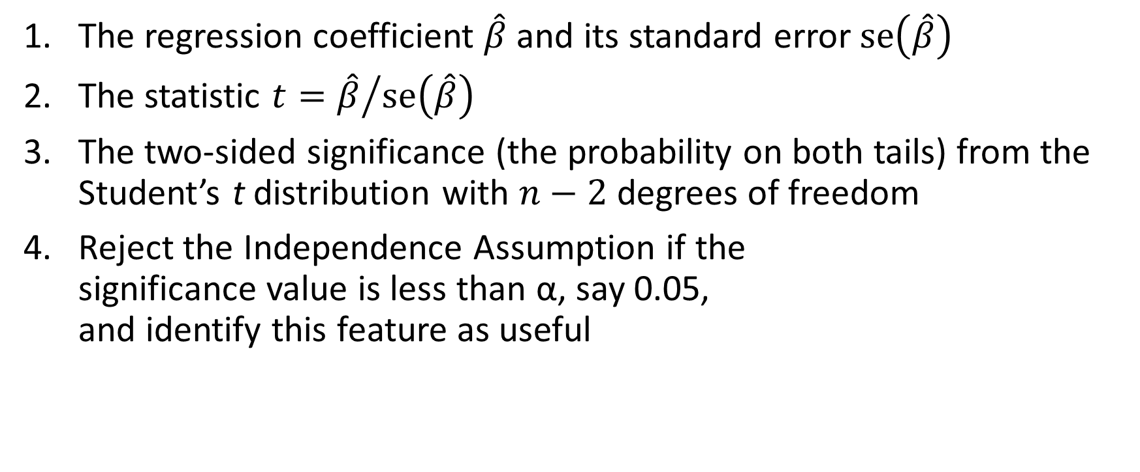
Student’s t Test - Procedure
The regression coefficient $\hat{β}$ and its standard error $se\left(\hat{β}\right)$
The statistic $t={\hat{β}}/{se\left(\hat{β}\right)}$
The two-sided significance (the probability on both tails) from the Student’s t distribution with $n−2$ degrees of freedom
Reject the Independence Assumption if the significance value is less than α, say 0.05, and identify this feature as useful

Slide 32
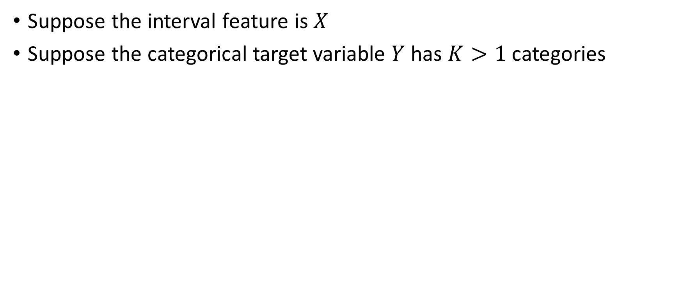
Deviance Test
Suppose the interval feature is $X$
Suppose the categorical target variable $Y$ has $K>1$ categories
IF the feature is statistically independent of the target variable, then the feature will not help predict the target variable
THEN the goodness-of-fit of a logistic model with the interval feature $X$ should be the same as another logistic model without the interval feature is $X$
THEN the goodness-of-fit of a logistic model with the interval feature 𝑋 should be the same as another logistic model without the interval feature is 𝑋
THEREFORE, the Deviance statistic should be small

Slide 33
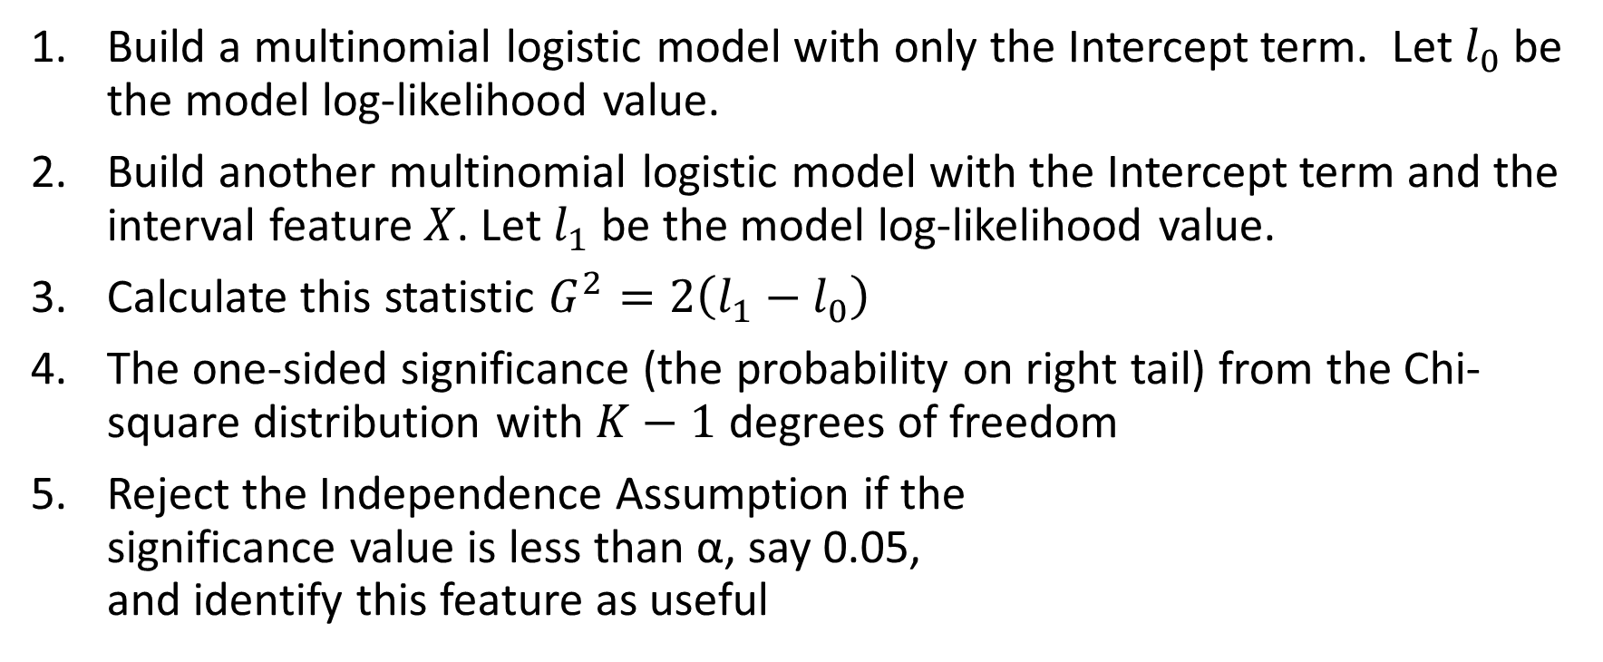
Deviance Test - Procedure
Build a multinomial logistic model with only the Intercept term. Let $l_{0}$ be the model log-likelihood value.
Build another multinomial logistic model with the Intercept term and the interval feature $X$. Let $l_{1}$ be the model log-likelihood value.
Calculate this statistic $G^{2}=2\left(l_{1}−l_{0}\right)$
The one-sided significance (the probability on right tail) from the Chi-square distribution with $K−1$ degrees of freedom
Reject the Independence Assumption if the significance value is less than α, say 0.05, and identify this feature as useful

Slide 34
The Home Equity Loan Example
Categorical Feature: REASON, JOB, DEROG, DELINQ, and NINQ
Interval Feature: LOAN, MORTDUE, VALUE, YOJ, CLAGE, CLNO, and DEBTINC
5,960 records, 13 variables read from hmeq.csv
3,364 complete records analyzed
Chi-square Test for categorical features
Deviance Test for Interval Feature
Categorical Target Variable: BAD
Ranking based on Significance

Slide 35
The Home Equity Loan Example
# Define a function that performs the Chi-square test
def ChiSquareTest (
xCat, # input categorical feature
yCat, # input categorical target variable
debug = 'N' # debugging flag (Y/N)
):
obsCount = pandas.crosstab(index = xCat, columns = yCat, margins = False, dropna = True)
cTotal = obsCount.sum(axis = 1)
rTotal = obsCount.sum(axis = 0)
nTotal = numpy.sum(rTotal)
expCount = numpy.outer(cTotal, (rTotal / nTotal))
# Debugging codes omitted to enhance readability
chiSqStat = ((obsCount - expCount)**2 / expCount).to_numpy().sum()
chiSqDf = (obsCount.shape[0] - 1.0) * (obsCount.shape[1] - 1.0)
chiSqSig = scipy.stats.chi2.sf(chiSqStat, chiSqDf)
cramerV = chiSqStat / nTotal
if (cTotal.size > rTotal.size):
cramerV = cramerV / (rTotal.size - 1.0)
else:
cramerV = cramerV / (cTotal.size - 1.0)
cramerV = numpy.sqrt(cramerV)
return(chiSqStat, chiSqDf, chiSqSig)
Week 9 Identify Useful Feature for Cat Target.py

Slide 36
The Home Equity Loan Example
# Define a function that performs the Deviance test
def DevianceTest (
xInt, # input interval feature
yCat, # input categorical target variable
debug = 'N' # debugging flag (Y/N)
):
y = yCat.astype('category')
# Model 0 is yCat = Intercept
X = numpy.where(yCat.notnull(), 1, 0)
objLogit = smodel.MNLogit(y, X)
thisFit = objLogit.fit(method = 'newton', full_output = True, maxiter = 100, tol = 1e-8)
thisParameter = thisFit.params
LLK0 = objLogit.loglike(thisParameter.values)
# Debugging codes omitted to enhance readability
# Model 1 is yCat = Intercept + xInt
X = smodel.add_constant(xInt, prepend = True)
objLogit = smodel.MNLogit(y, X)
thisFit = objLogit.fit(method = 'newton', full_output = True, maxiter = 100, tol = 1e-8)
thisParameter = thisFit.params
LLK1 = objLogit.loglike(thisParameter.values)
# Debugging codes omitted to enhance readability
# Calculate the deviance
devianceStat = 2.0 * (LLK1 - LLK0)
devianceDf = (len(y.cat.categories) - 1.0)
devianceSig = scipy.stats.chi2.sf(devianceStat, devianceDf)
mcFaddenRSq = 1.0 - (LLK1 / LLK0)
return(devianceStat, devianceDf, devianceSig)
Week 9 Identify Useful Feature for Cat Target.py

Slide 37
The Home Equity Loan Example
# The Home Equity Loan example
catPred = ['REASON', 'JOB', 'DEROG', 'DELINQ', 'NINQ']
intPred = ['LOAN', 'MORTDUE', 'VALUE', 'YOJ', 'CLAGE', 'CLNO', 'DEBTINC']
hmeq = pandas.read_csv('C:\\Users\\minlam\\Documents\\IIT\\Machine Learning\\Data\\hmeq.csv',
delimiter=',', usecols = ['BAD']+catPred+intPred)
hmeq = hmeq.dropna()
testResult = pandas.DataFrame(index = catPred + intPred,
columns = ['Test', 'Statistic', 'DF', 'Significance', 'Association', 'Measure'])
for pred in catPred:
chiSqStat, chiSqDf, chiSqSig, cramerV = ChiSquareTest(hmeq[pred], hmeq['BAD'], debug = 'Y')
testResult.loc[pred] = ['Chi-square', chiSqStat, chiSqDf, chiSqSig, 'Cramer''V', cramerV]
for pred in intPred:
devianceStat, devianceDf, devianceSig, mcFaddenRSq = DevianceTest(hmeq[pred], hmeq['BAD'], debug = 'Y')
testResult.loc[pred] = ['Deviance', devianceStat, devianceDf, devianceSig, 'McFadden''s R^2', mcFaddenRSq]
rankSig = testResult.sort_values('Significance', axis = 0, ascending = True)
rankAssoc = testResult.sort_values('Measure', axis = 0, ascending = False)
Week 9 Identify Useful Feature for Cat Target.py

Slide 38
The Home Equity Loan Example
Feature | Test | Statistic | DF | Significance
DELINQ | Chi-square | 302.7277966 | 9 | 6.89E-60
DEROG | Chi-square | 237.8856927 | 10 | 1.90E-45
DEBTINC | Deviance | 144.4416285 | 1 | 2.84E-33
NINQ | Chi-square | 97.5806366 | 12 | 1.66E-15
CLAGE | Deviance | 50.6898168 | 1 | 1.08E-12
JOB | Chi-square | 36.2546912 | 5 | 0.0000008
YOJ | Deviance | 14.8204053 | 1 | 0.0001182
LOAN | Deviance | 3.5110923 | 1 | 0.0609593
VALUE | Deviance | 2.4397505 | 1 | 0.1182950
MORTDUE | Deviance | 0.9512081 | 1 | 0.3294120
CLNO | Deviance | 0.1896254 | 1 | 0.6632286
REASON | Chi-square | 0.1312973 | 1 | 0.7170907

Slide 39
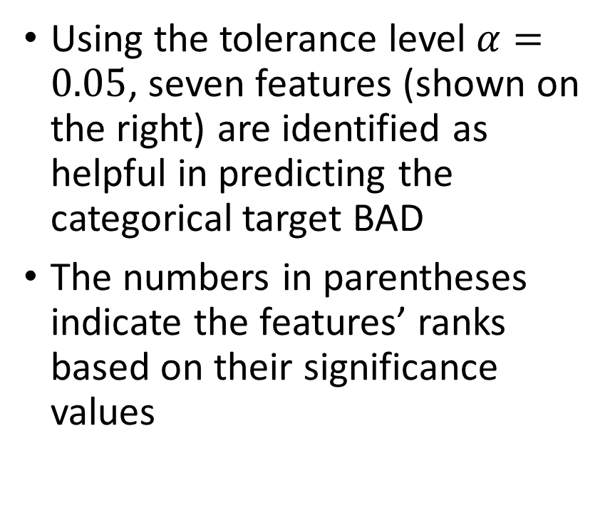
The Home Equity Loan Example
Using the tolerance level $α=0.05$, seven features (shown on the right) are identified as helpful in predicting the categorical target BAD
The numbers in parentheses indicate the features’ ranks based on their significance values
Categorical
DELINQ (1)
Interval
CLAGE (5)
DEROG (2)
NINQ (4)
JOB (6)
DEBTINC (3)
YOJ (7)

Slide 40

Feature Importance
Feature | Test | Statistic | DF | Significance
DELINQ | Chi-square | 302.7277966 | 9 | 6.89E-60
DEROG | Chi-square | 237.8856927 | 10 | 1.90E-45
DEBTINC | Deviance | 144.4416285 | 1 | 2.84E-33
NINQ | Chi-square | 97.5806366 | 12 | 1.66E-15
CLAGE | Deviance | 50.6898168 | 1 | 1.08E-12
JOB | Chi-square | 36.2546912 | 5 | 0.0000008
YOJ | Deviance | 14.8204053 | 1 | 0.0001182
In the previous example, the significances of seven features are less than 0.05.
Among them:
DELINQ has the smallest significance at 6.89E-60
YOJ has the largest significance at 0.0001182
Do these significances carry the same weights in our decision?
Do these significances indicate that some features are more important than others?

Slide 41
Common Measures for Feature Importance
Significance
Rank significances on the logarithm scale
Suppose the significance of a statistical test is $0<p≤1$, then calculate importance as $−\log_{10}\left(p\right)$.
Suppose the significance of a statistical test is 0<𝑝≤1, then calculate importance as −log_10⁡(𝑝).
Association
Measure the strength of association
Calculate the appropriate statistic for measuring the strength of association between the feature and the target variable.
Popularity
How popular a feature is used in predicting the target?
Make a random subset of the features available for training the algorithm
The higher the importance value, the more predictive a feature for the target variable.
Record how often a feature is selected or included by the algorithm in the model

Slide 42
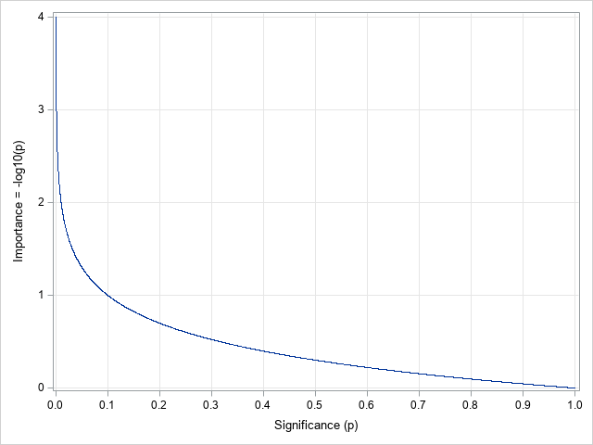

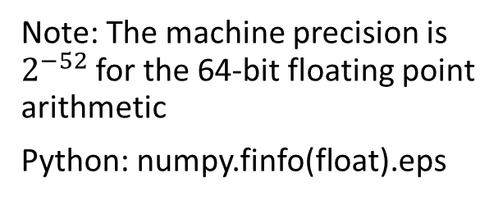
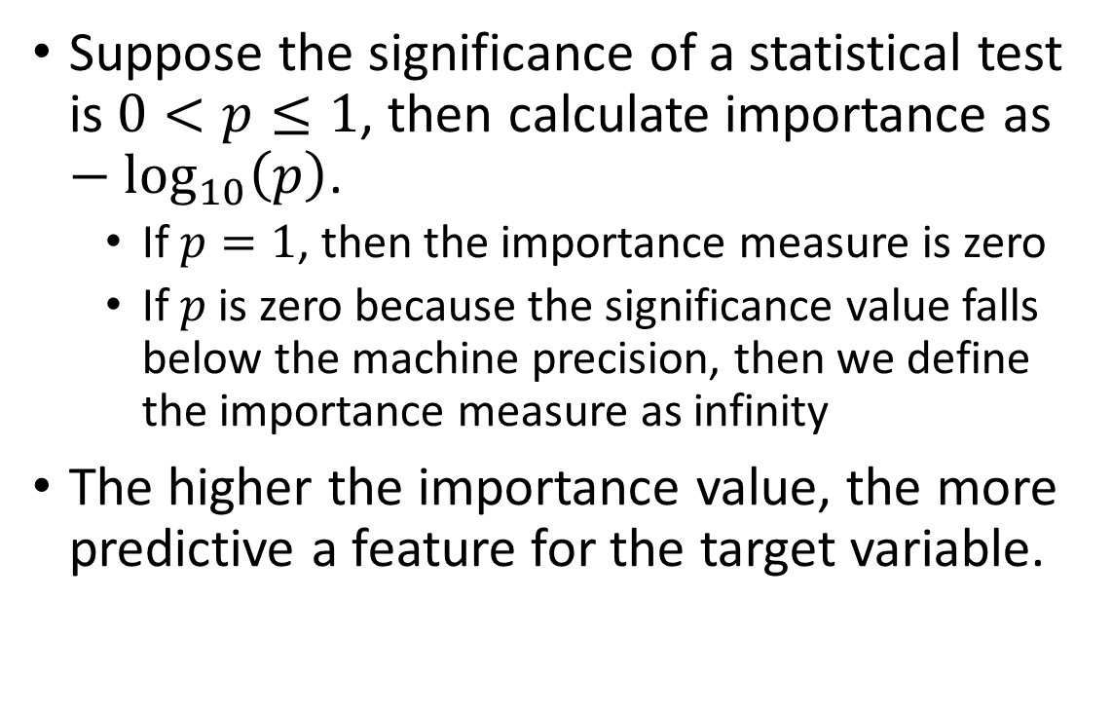
Feature Importance: $−\log_{10}\left(Significance\right)$
Suppose the significance of a statistical test is $0<p≤1$, then calculate importance as $−\log_{10}\left(p\right)$.
If $p=1$, then the importance measure is zero
If $p$ is zero because the significance value falls below the machine precision, then we define the importance measure as infinity
The higher the importance value, the more predictive a feature for the target variable.
Note: The machine precision is $2^{−52}$ for the 64-bit floating point arithmetic
Python: numpy.finfo(float).eps

Slide 43
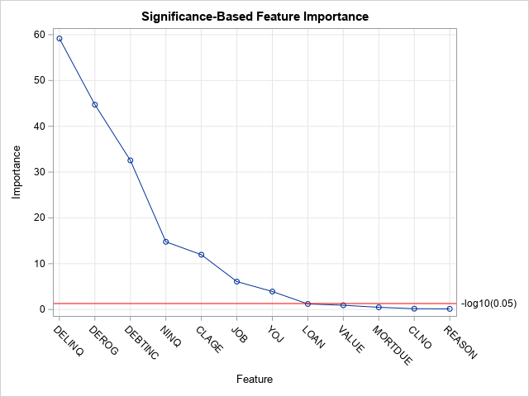
The Home Equity Loan Example
Feature | Test | Significance | Importance
DELINQ | Chi-square | 6.89E-60 | 59.16
DEROG | Chi-square | 1.90E-45 | 44.72
DEBTINC | Deviance | 2.84E-33 | 32.55
NINQ | Chi-square | 1.66E-15 | 14.78
CLAGE | Deviance | 1.08E-12 | 11.97
JOB | Chi-square | 0.0000008 | 6.10
YOJ | Deviance | 0.0001182 | 3.93
LOAN | Deviance | 0.0609593 | 1.21
VALUE | Deviance | 0.1182950 | 0.93
MORTDUE | Deviance | 0.3294120 | 0.48
CLNO | Deviance | 0.6632286 | 0.18
REASON | Chi-square | 0.7170907 | 0.14
Week 9 Identify Useful Feature for Cat Target.py

Slide 44
Association Based Feature Importance
We prefer the association-based importance measure to be:
Positive
Between zero and one
A higher value indicates more important, and a lower value indicates less important
Appropriate Association Measure |  | Target Variable
 |  | Categorical | Interval
Input Feature | Categorical | Cramer’s V | Eta-squared
 | Interval | McFadden's Pseudo R^2 | Squared Pearson Correlation

Slide 45
Cramer’s V
Suppose the categorical target variable $Y$ has $K>1$ categories
Suppose the categorical feature $X$ has $L>1$ categories
Let $n_{ij}≥0, i=1,…, L$ and $j=1,…,K$ be the number of observations in the $i^{th}$ category of the feature and the $j^{th}$ category of the target.
The marginal counts are:
Across Column: $n_{i+}=\sum_{j=1}^{K}{n_{ij}}$, $i=1,…, L$
Across Row: $n_{+j}=\sum_{i=1}^{L}{n_{ij}}$, $j=1,…,K$
Across Cell: $n_{++}=\sum_{i=1}^{L}{\sum_{j=1}^{K}{n_{ij}}}$

Slide 46
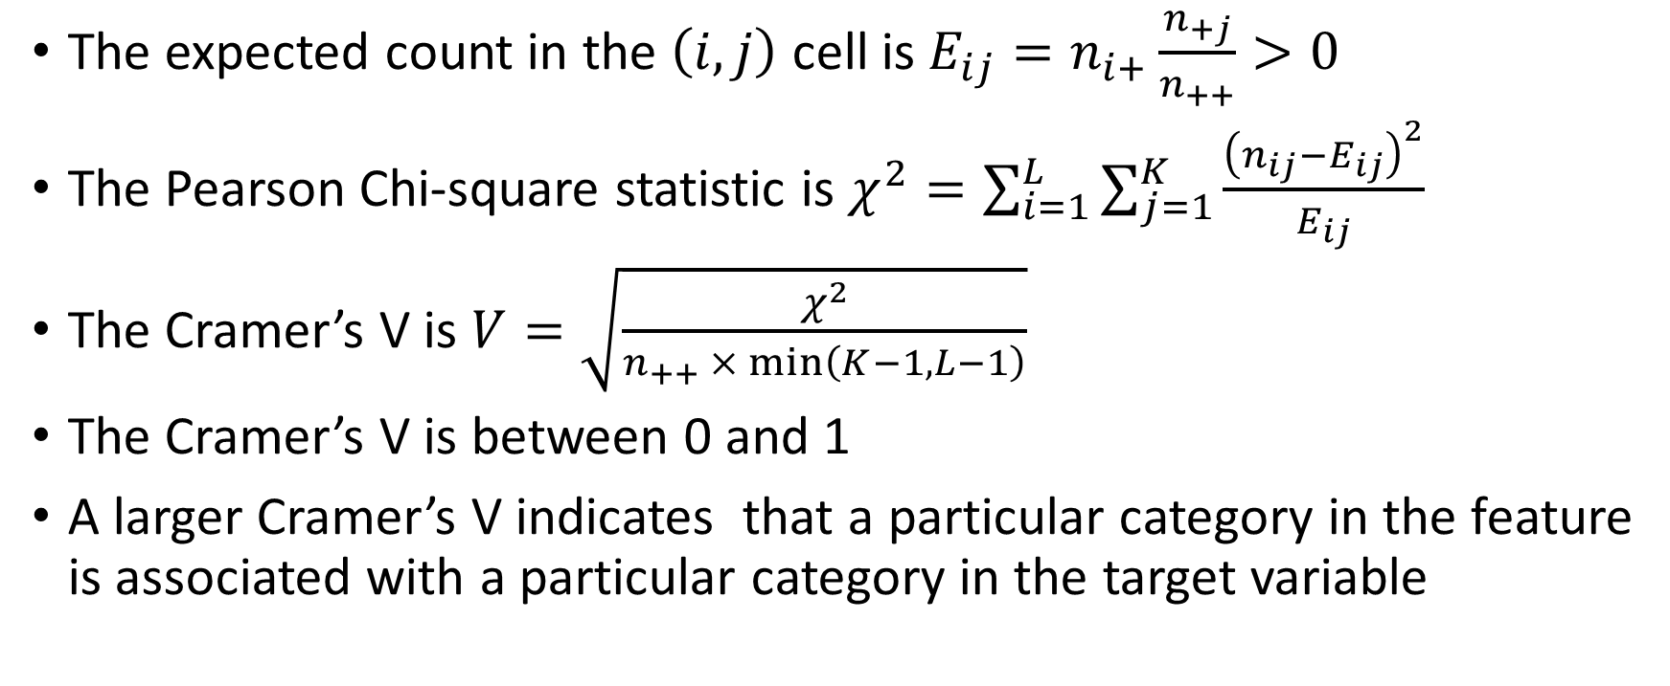
Cramer’s V
The expected count in the $\left(i,j\right)$ cell is $E_{ij}=n_{i+}\frac{n_{+j}}{n_{++}}>0$
The Pearson Chi-square statistic is $χ^{2}=\sum_{i=1}^{L}{\sum_{j=1}^{K}{\frac{{\left(n_{ij}−E_{ij}\right)}^{2}}{E_{ij}}}}$
The Cramer’s V is $V=\sqrt{\frac{χ^{2}}{n_{++} × min\left(K−1, L−1\right)}}$
The Cramer’s V is between 0 and 1
A larger Cramer’s V indicates that a particular category in the feature is associated with a particular category in the target variable

Slide 47
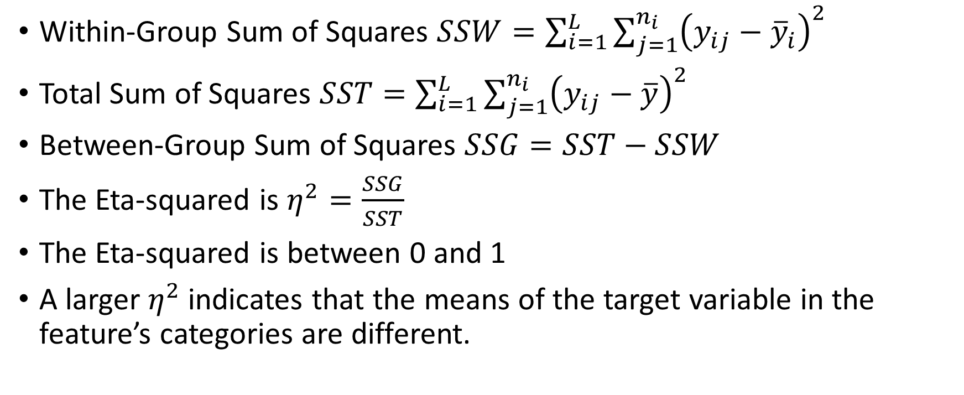
Eta-squared
Within-Group Sum of Squares $SSW=\sum_{i=1}^{L}{\sum_{j=1}^{n_{i}}{{\left(y_{ij}−{\overline{y}}_{i}\right)}^{2}}}$
Total Sum of Squares $SST=\sum_{i=1}^{L}{\sum_{j=1}^{n_{i}}{{\left(y_{ij}−\overline{y}\right)}^{2}}}$
Between-Group Sum of Squares $SSG=SST−SSW$
The Eta-squared is $η^{2}=\frac{SSG}{SST}$
The Eta-squared is between 0 and 1
A larger $η^{2}$indicates that the means of the target variable in the feature’s categories are different.

Slide 48
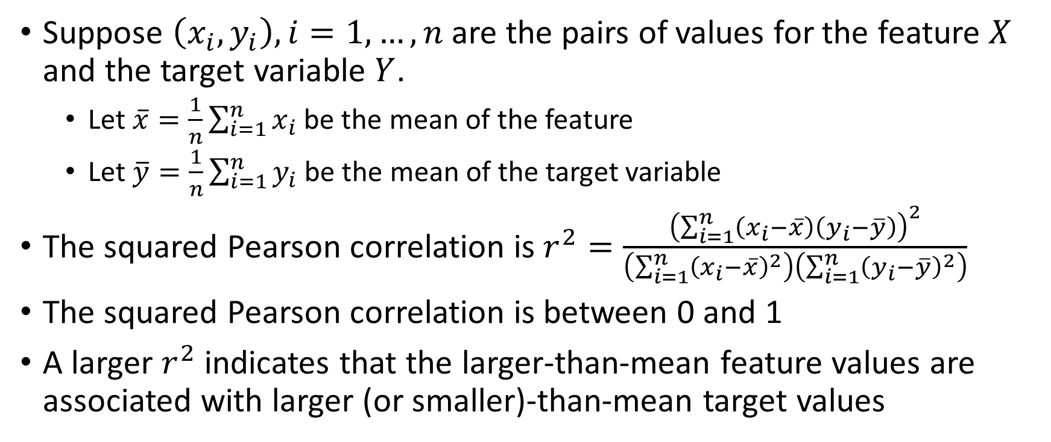
Squared Pearson Correlation
Suppose $\left(x_{i}, y_{i}\right), i=1,…,n$ are the pairs of values for the feature $X$ and the target variable $Y$.
Let $\overline{x}=\frac{1}{n}\sum_{i=1}^{n}{x_{i}}$ be the mean of the feature
Let $\overline{y}=\frac{1}{n}\sum_{i=1}^{n}{y_{i}}$ be the mean of the target variable
The squared Pearson correlation is $r^{2}=\frac{{\left(\sum_{i=1}^{n}{\left(x_{i}−\overline{x}\right)\left(y_{i}−\overline{y}\right)}\right)}^{2}}{\left(\sum_{i=1}^{n}{{\left(x_{i}−\overline{x}\right)}^{2}}\right)\left(\sum_{i=1}^{n}{{\left(y_{i}−\overline{y}\right)}^{2}}\right)}$
The squared Pearson correlation is between 0 and 1
A larger $r^{2}$ indicates that the larger-than-mean feature values are associated with larger (or smaller)-than-mean target values

Slide 49
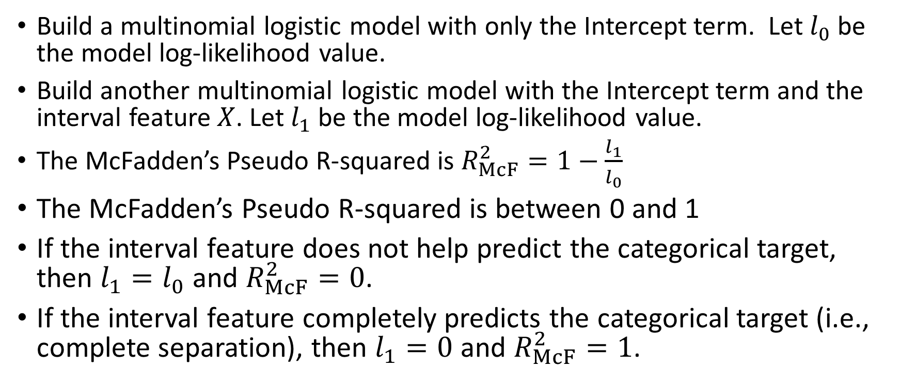
McFadden's Pseudo R^2
Build a multinomial logistic model with only the Intercept term. Let $l_{0}$ be the model log-likelihood value.
Build another multinomial logistic model with the Intercept term and the interval feature $X$. Let $l_{1}$ be the model log-likelihood value.
The McFadden’s Pseudo R-squared is $R_{McF}^{2}=1−\frac{l_{1}}{l_{0}}$
The McFadden’s Pseudo R-squared is between 0 and 1
If the interval feature does not help predict the categorical target, then $l_{1}=l_{0}$ and $R_{McF}^{2}=0$.
If the interval feature completely predicts the categorical target (i.e., complete separation), then $l_{1}=0$ and $R_{McF}^{2}=1$.

Slide 50
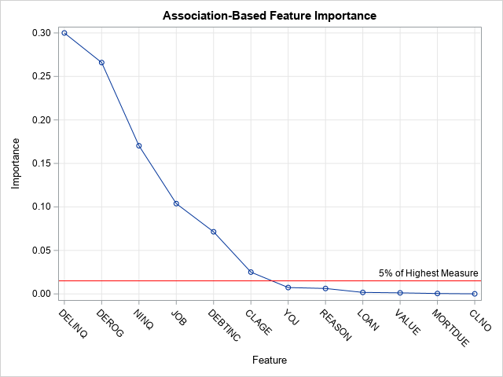
The Home Equity Loan Example
Feature | Association | Measure
DELINQ | CramerV | 0.2999840
DEROG | CramerV | 0.2659232
NINQ | CramerV | 0.1703154
JOB | CramerV | 0.1038136
DEBTINC | McFaddens R^2 | 0.0714112
CLAGE | McFaddens R^2 | 0.0250608
YOJ | McFaddens R^2 | 0.0073271
REASON | CramerV | 0.0062474
LOAN | McFaddens R^2 | 0.0017359
VALUE | McFaddens R^2 | 0.0012062
MORTDUE | McFaddens R^2 | 0.0004703
CLNO | McFaddens R^2 | 9.375E-05
Week 9 Identify Useful Feature for Cat Target.py

Slide 51
The Home Equity Loan Example
Feature | Test | Significance
DELINQ | Chi-square | 6.89E-60
DEROG | Chi-square | 1.90E-45
DEBTINC | Deviance | 2.84E-33
NINQ | Chi-square | 1.66E-15
CLAGE | Deviance | 1.08E-12
JOB | Chi-square | 0.0000008
YOJ | Deviance | 0.0001182
LOAN | Deviance | 0.0609593
VALUE | Deviance | 0.1182950
MORTDUE | Deviance | 0.3294120
CLNO | Deviance | 0.6632286
REASON | Chi-square | 0.7170907
Feature | Association | Measure
DELINQ | CramerV | 0.2999840
DEROG | CramerV | 0.2659232
NINQ | CramerV | 0.1703154
JOB | CramerV | 0.1038136
DEBTINC | McFaddens R^2 | 0.0714112
CLAGE | McFaddens R^2 | 0.0250608
YOJ | McFaddens R^2 | 0.0073271
REASON | CramerV | 0.0062474
LOAN | McFaddens R^2 | 0.0017359
VALUE | McFaddens R^2 | 0.0012062
MORTDUE | McFaddens R^2 | 0.0004703
CLNO | McFaddens R^2 | 9.375E-05
Week 9 Identify Useful Feature for Cat Target.py

Slide 52
Popularity Based Feature Importance
How often a feature is used in predicting the target variable?
How can we answer if we build the model once on a single dataset?
How about making a random subset of the features available for training the algorithm?
An idea is to use the Random Forest algorithm

Slide 53
Random Forest Algorithm
Randomly select a subset of features from the available features
Optionally, create a bootstrap sample from the training data
Build a decision tree with the user specifications
Generate predictions or classifications from the decision tree
Repeat Step 1 to Step 5 to obtain an array of predictions
Aggregate the predicted value or category from all the tree

Slide 54
Popularity-Based Feature Importance
Impurity
Entropy or Gini Metric
The Feature Importance is the Mean Decrease Impurity (MDI) of a feature among all the randomized decision trees.
Categorical
Treatment for categorical feature
Create dummy variables for categorical features
The base in calculating the mean is the total number of nodes that were split by the feature
The weights are the frequencies of the feature’s categories
Use the weighted mean of the Feature Importance of the dummy variables as the Feature Importance of the categorical feature
Beware: The Feature Importance of all features MAY NOT add up to 1.0

Slide 55
Python sklearn.ensemble
Function
RandomForestClassifier for categorical target
RandomForestRegressor for interval target
Specifications
n_estimators: number of trees in the forest
bootstrap: create bootstrap sample?
max_features: number of features to consider

Slide 56
The Home Equity Loan Example
import sklearn.ensemble as ensemble
# Feature Importance from Random Forest
x_category = hmeq[catPred].astype('category')
xCat = pandas.get_dummies(x_category)
xData = xCat.join(hmeq[intPred])
yData = hmeq['BAD'].astype('category')
_objRF = ensemble.RandomForestClassifier(criterion = 'entropy', n_estimators = 1000, max_features = 'sqrt',
max_depth = 10, random_state = 27513, bootstrap = True)
thisRandomForest = _objRF.fit(xData, yData)
thisFeatureImp = thisRandomForest.feature_importances_
Week 9 Identify Useful Feature for Cat Target.py

Slide 57
The Home Equity Loan Example
Feature | Parameter | Weight | _Feature_IMP_
REASON | REASON_DebtCon | 2369 | 0.0077
REASON | REASON_HomeImp | 995 | 0.0078
JOB | JOB_Mgr | 450 | 0.0067
JOB | JOB_Office | 577 | 0.0111
JOB | JOB_Other | 1286 | 0.0094
JOB | JOB_ProfExe | 899 | 0.0079
JOB | JOB_Sales | 53 | 0.0097
JOB | JOB_Self | 99 | 0.0056
DEROG | DEROG_0.0 | 3052 | 0.0346
DEROG | DEROG_1.0 | 200 | 0.0077
DEROG | DEROG_2.0 | 79 | 0.0080
DEROG | DEROG_3.0 | 22 | 0.0101
DEROG | DEROG_4.0 | 3 | 0.0016
DEROG | DEROG_5.0 | 1 | 0.0005
DEROG | DEROG_6.0 | 2 | 0.0018
DEROG | DEROG_7.0 | 2 | 0.0013
DEROG | DEROG_8.0 | 1 | 0.0004
DEROG | DEROG_9.0 | 1 | 0.0007
DEROG | DEROG_10.0 | 1 | 0.0012
Feature | Parameter | Weight | _Feature_IMP_
DELINQ | DELINQ_0.0 | 2824 | 0.0483
DELINQ | DELINQ_1.0 | 324 | 0.0097
DELINQ | DELINQ_2.0 | 124 | 0.0103
DELINQ | DELINQ_3.0 | 50 | 0.0032
DELINQ | DELINQ_4.0 | 21 | 0.0057
DELINQ | DELINQ_5.0 | 6 | 0.0083
DELINQ | DELINQ_6.0 | 7 | 0.0111
DELINQ | DELINQ_7.0 | 6 | 0.0145
DELINQ | DELINQ_8.0 | 1 | 0.0011
DELINQ | DELINQ_10.0 | 1 | 0.0012
NINQ | NINQ_0.0 | 1672 | 0.0099
NINQ | NINQ_1.0 | 820 | 0.0084
NINQ | NINQ_2.0 | 456 | 0.0044
NINQ | NINQ_3.0 | 234 | 0.0052
NINQ | NINQ_4.0 | 75 | 0.0065
NINQ | NINQ_5.0 | 31 | 0.0069
NINQ | NINQ_6.0 | 22 | 0.0050
NINQ | NINQ_7.0 | 15 | 0.0027
NINQ | NINQ_8.0 | 12 | 0.0010
NINQ | NINQ_9.0 | 7 | 0.0014
NINQ | NINQ_10.0 | 17 | 0.0012
NINQ | NINQ_11.0 | 2 | 0.0000
NINQ | NINQ_13.0 | 1 | 0.0017
Feature | Parameter | Weight | _Feature_IMP_
LOAN | LOAN | 1 | 0.0675
MORTDUE | MORTDUE | 1 | 0.0624
VALUE | VALUE | 1 | 0.0789
YOJ | YOJ | 1 | 0.0495
CLAGE | CLAGE | 1 | 0.1018
CLNO | CLNO | 1 | 0.0661
DEBTINC | DEBTINC | 1 | 0.2723
Week 9 Identify Useful Feature for Cat Target.py

Slide 58
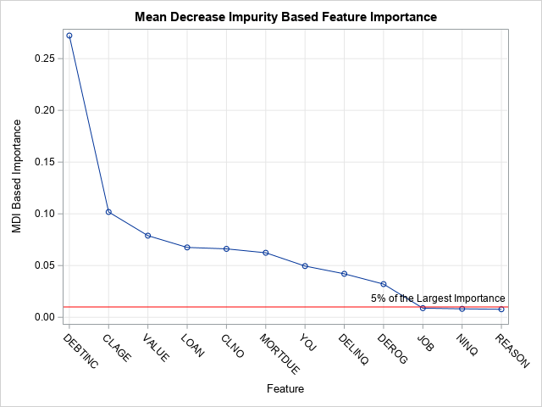
The Home Equity Loan Example
Feature | Level | Weighted MDI
DEBTINC | Interval | 0.272296
CLAGE | Interval | 0.101791
VALUE | Interval | 0.078898
LOAN | Interval | 0.067533
CLNO | Interval | 0.066138
MORTDUE | Interval | 0.062363
YOJ | Interval | 0.049517
DELINQ | Categorical | 0.042035
DEROG | Categorical | 0.032075
JOB | Categorical | 0.008833
NINQ | Categorical | 0.008185
REASON | Categorical | 0.007744
Week 9 Identify Useful Feature for Cat Target.py

Slide 59
Remarks on Feature Importance
Significance-based metric depends on the statistical power of the test in rejecting the Independence Assumption
Association-based metric may have different interpretation between categorical and interval features
Popularity-based metric involves binning or merging of feature’s values, thus is structurally different from other metrics

